Slide 1
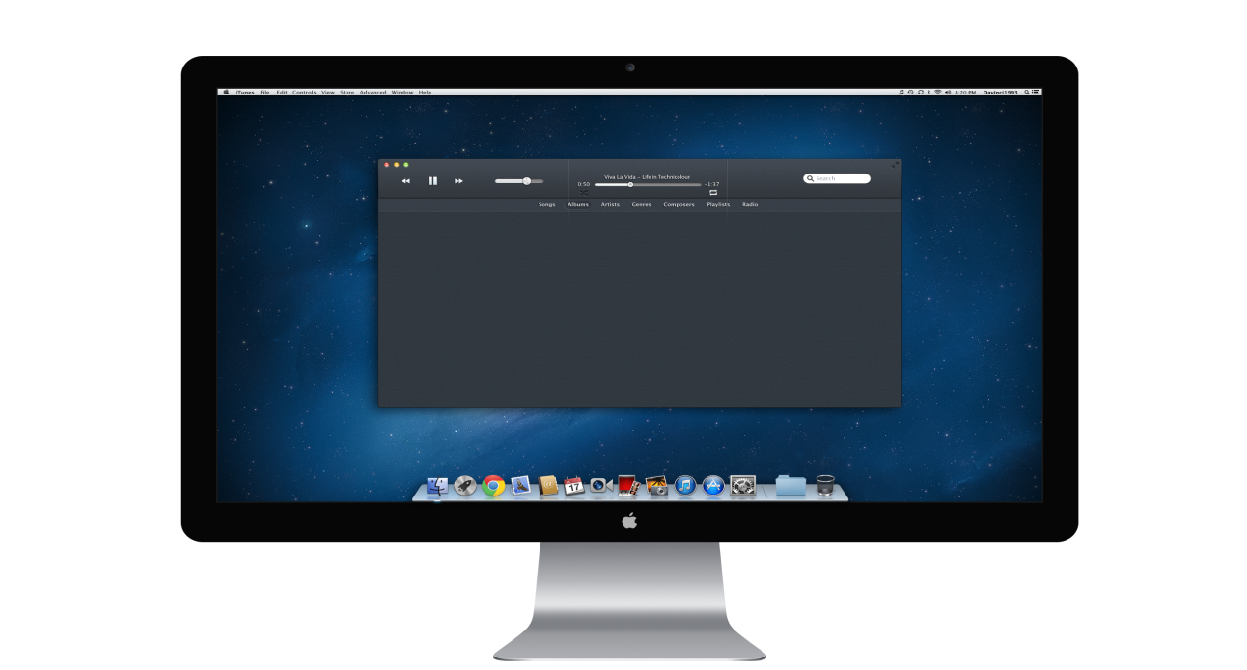
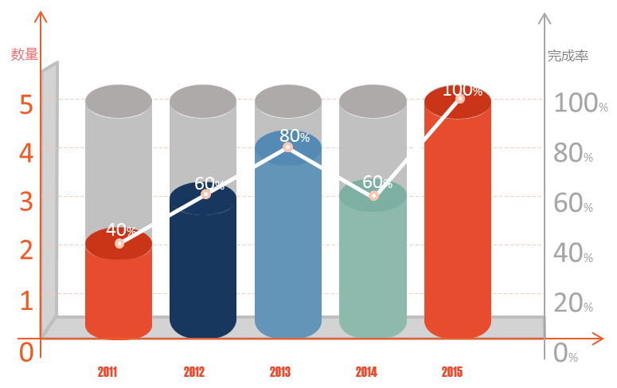
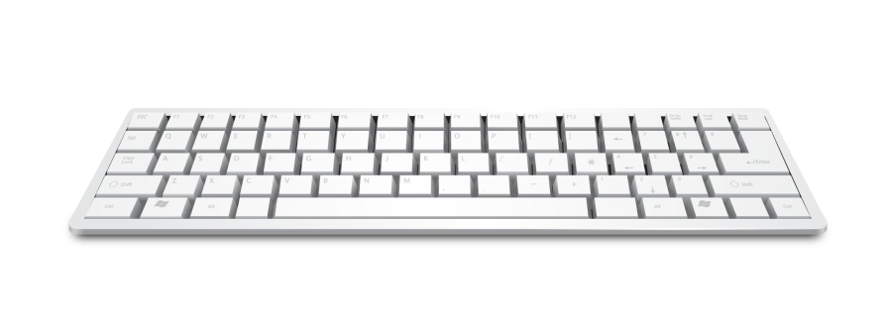

HARRY POTTER AND THE SORCERER’S STONE
MOVIE ANALYSIS
DESIGNED: Daniel Capone, Edward He, Anand Nishant, Sasidhar Sirivella

Slide 2


BACKGROUND
What makes HARRY POTTER AND THE SORCERER’S STONE so uniquely successful?
Made $32.3 million on its opening day, breaking the single day record
the film earned $974.8 million at the worldwide box office
The second highest-grossing film in history at the time, The year's highest-grossing film

Slide 3
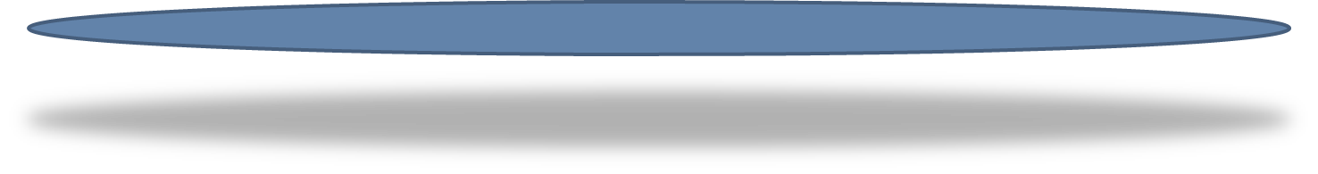
CONTENTS
01
SYNOPSIS
OPTION
02
METHODOLOGY
OPTION
03
RESULTS/INSIGHTS
OPTION
04
LIMITATIONS
OPTION

Slide 4
01
SYNOPSIS

Slide 5
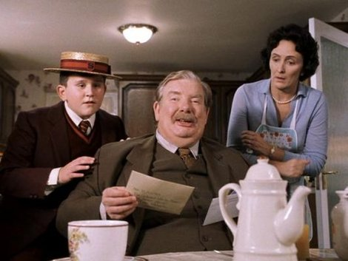
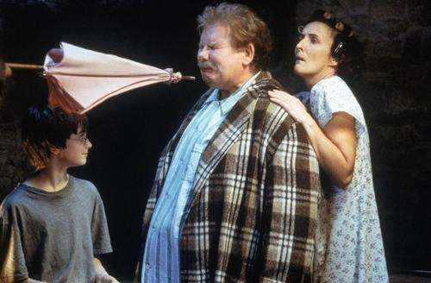
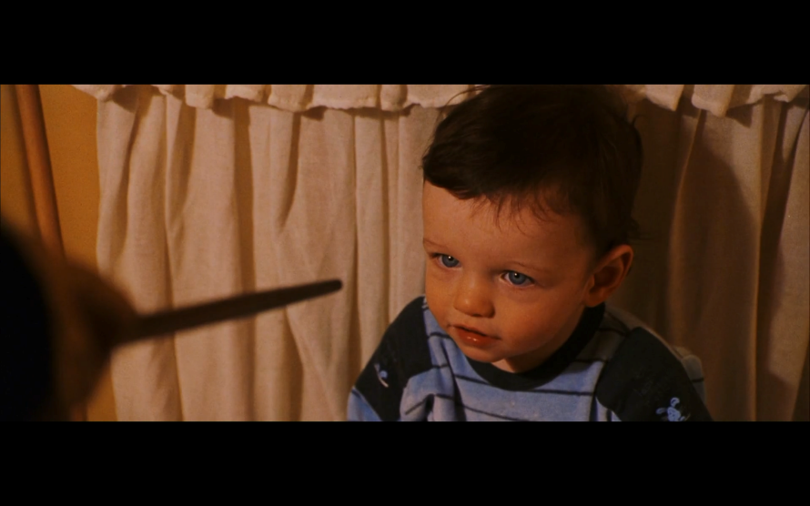
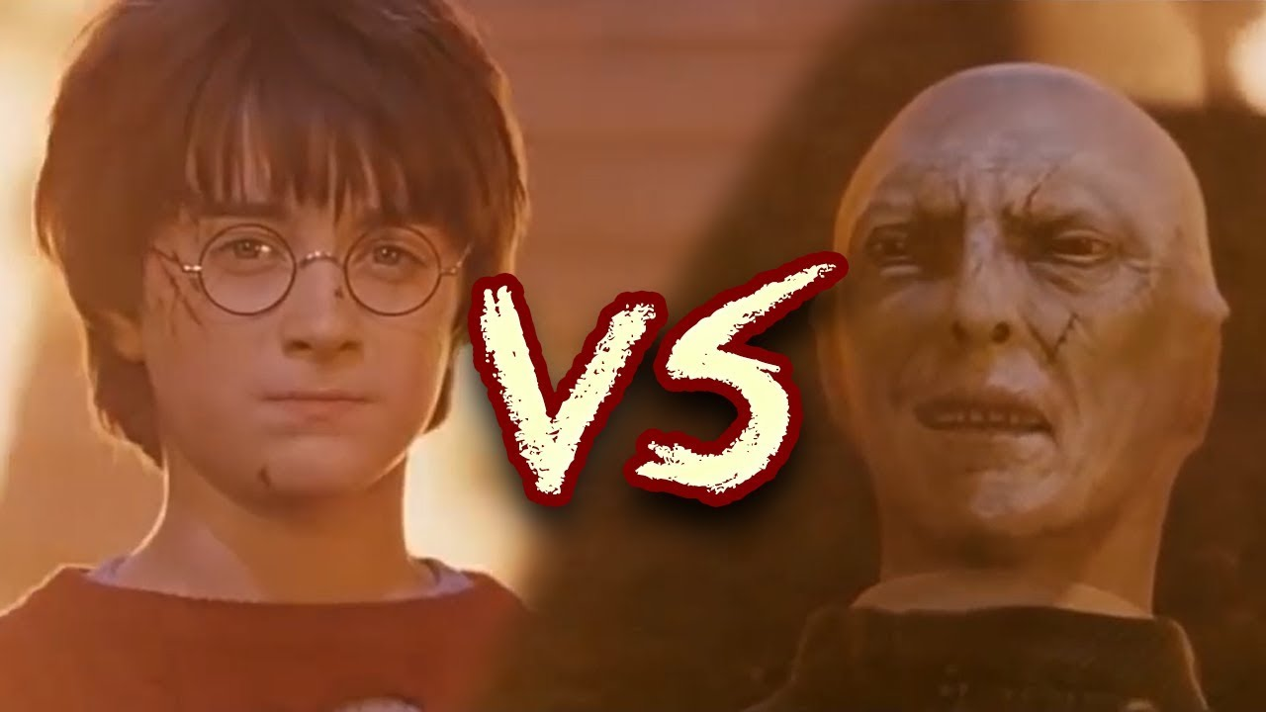
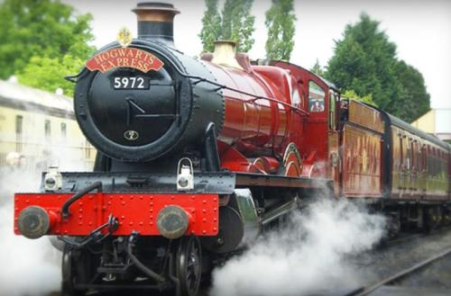
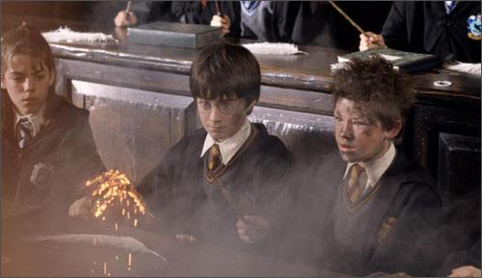
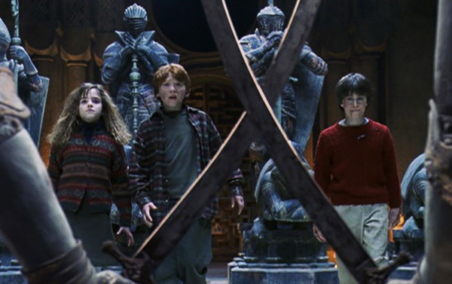
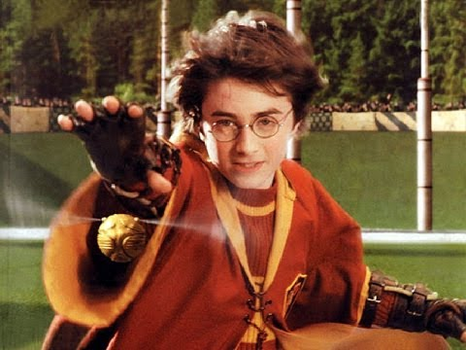
SYNOPSIS

Slide 6
02
METHODOLOGY

Slide 7
METHODOLOGY
Pre-processing
How?
Frequency Analysis
METHODOLOGY
Topic Analysis
Sentiment Analysis
Social Network Analysis

Slide 8
A
Pre-processing

Slide 9
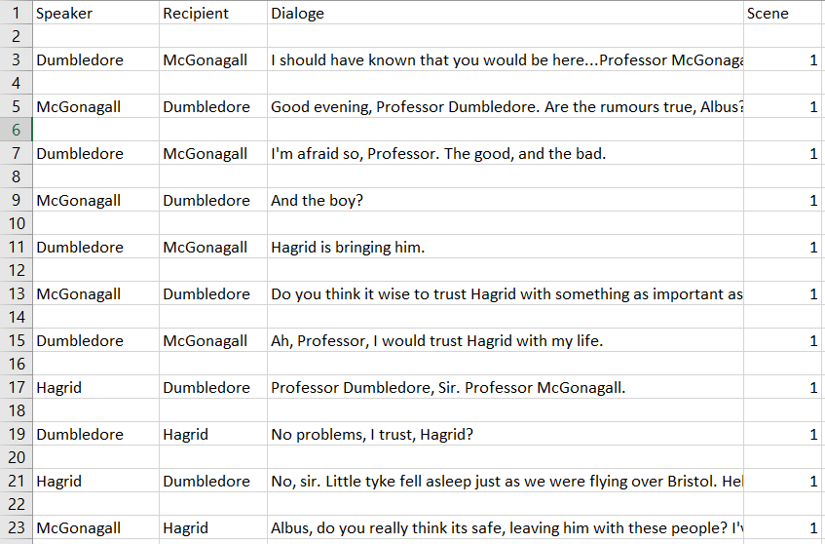
Preprocessing
Structuring
01
Speaker
Dialogue
Recipient
Scene
Dialogue Cleaning
02

Slide 10
B
Frequency Analysis

Slide 11
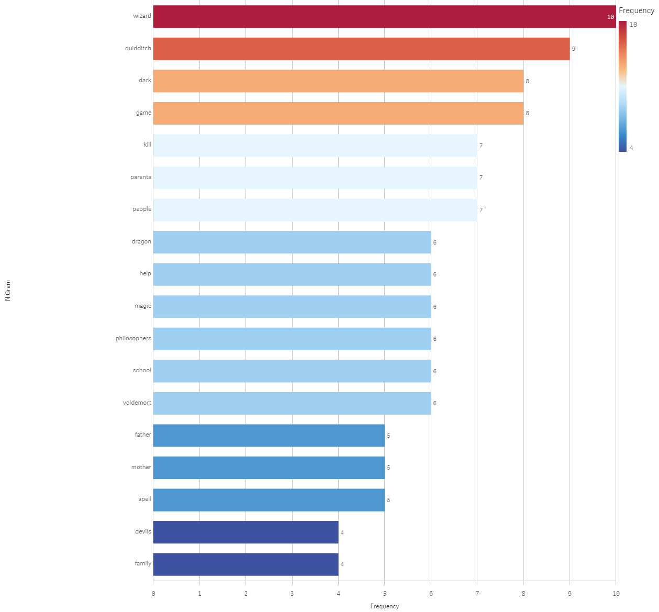
Frequency Analysis
Frequent words
Mysticism/Magic
Hardship
Family
First Experiences

Slide 12
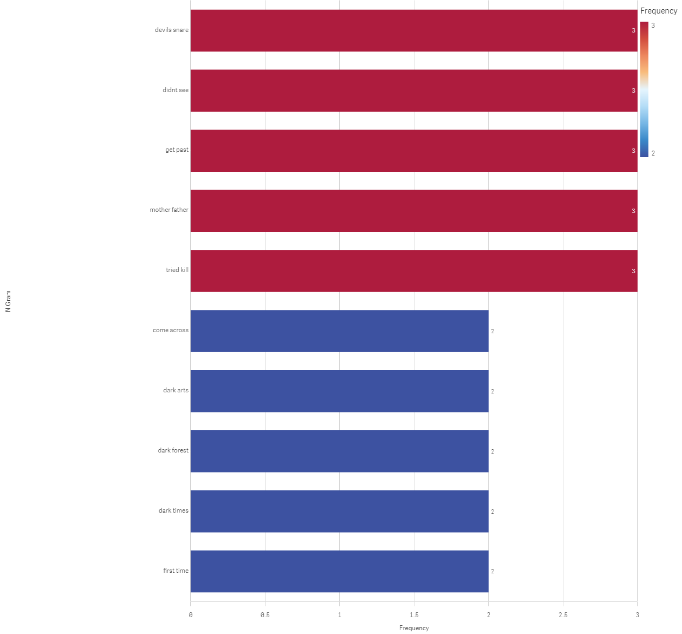
Frequency Analysis
Frequent words
Mysticism/Magic
Hardship
Family
First Experiences

Slide 13
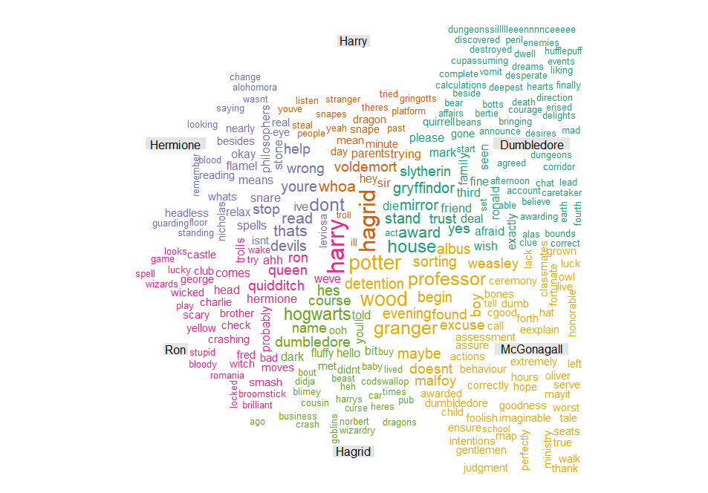
Frequency Analysis
Analysis
Dissecting movie’s plot
Genre Breakdown
Character Breakdown

Slide 14
C
Topic Analysis

Slide 15
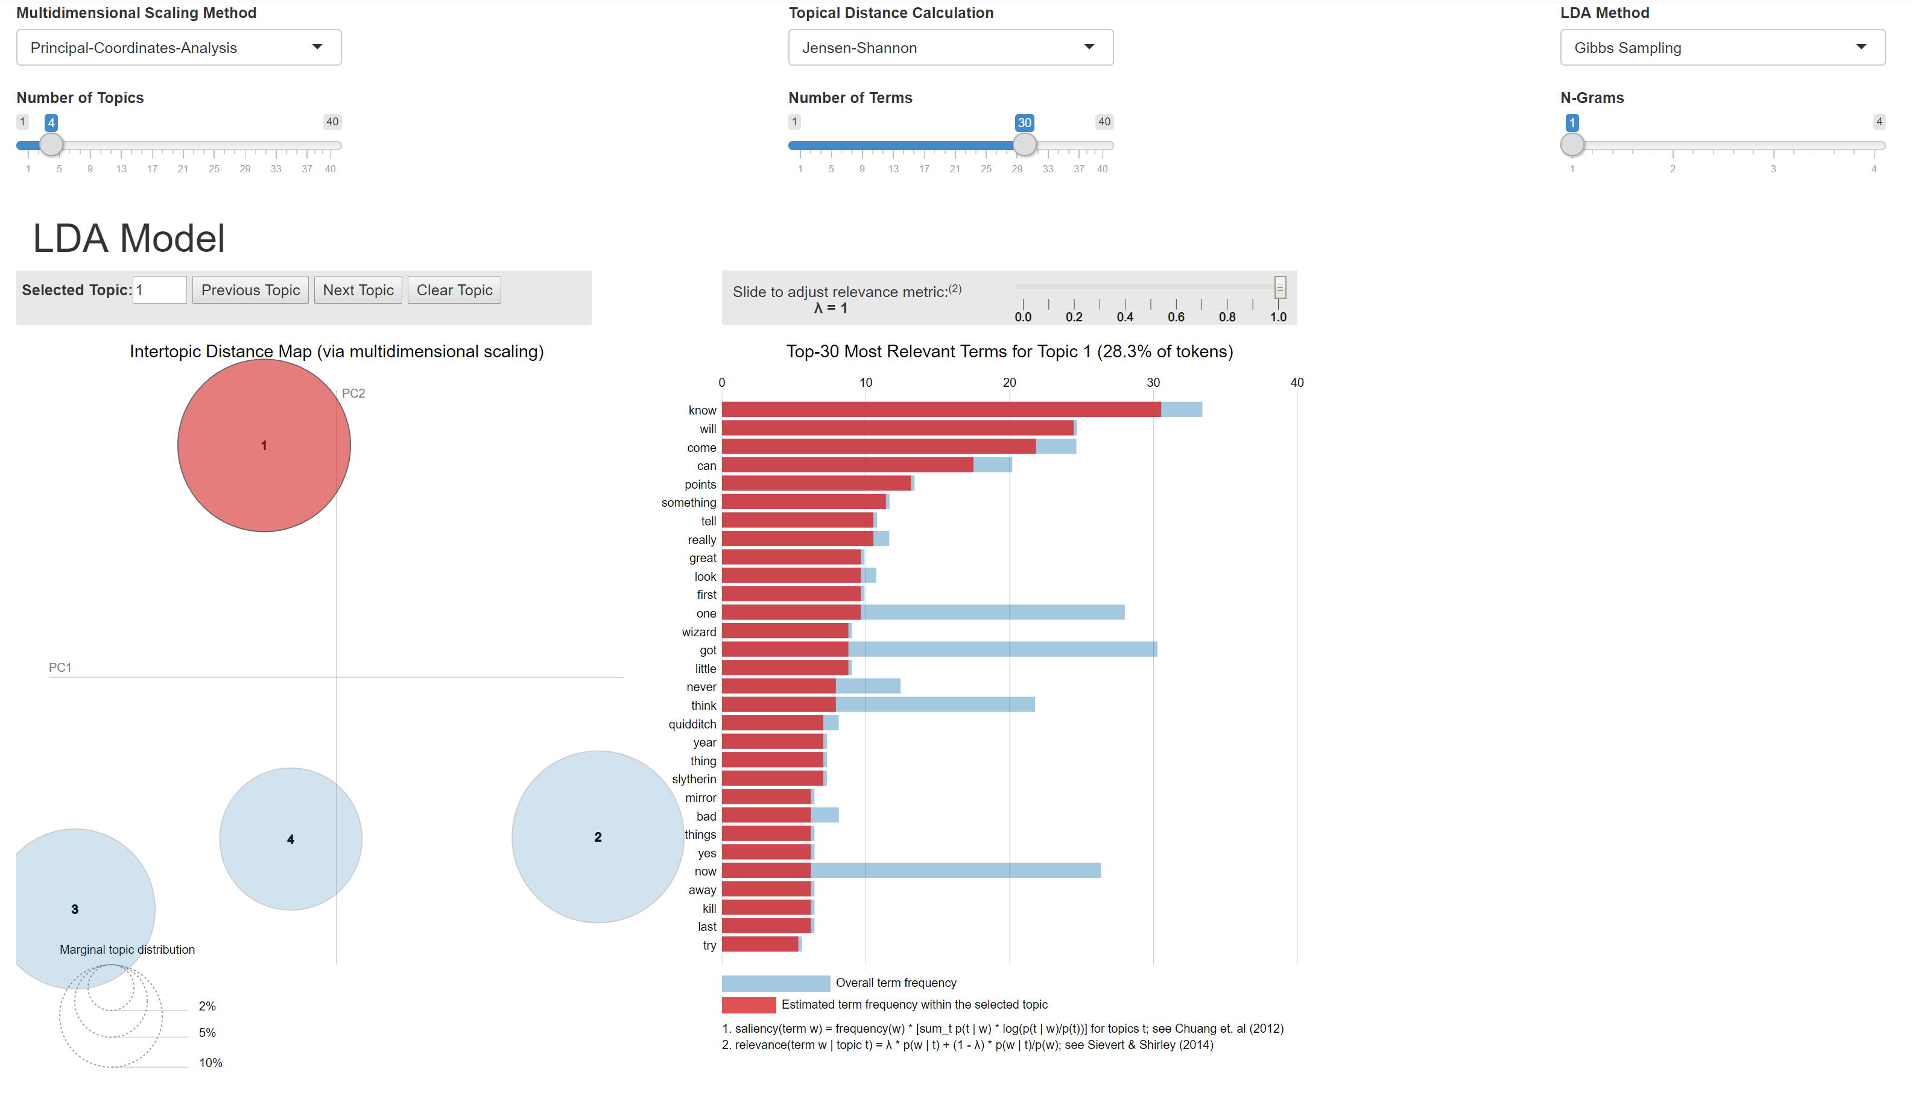
Topic Analysis

Slide 16
D
Sentiment Analysis

Slide 17
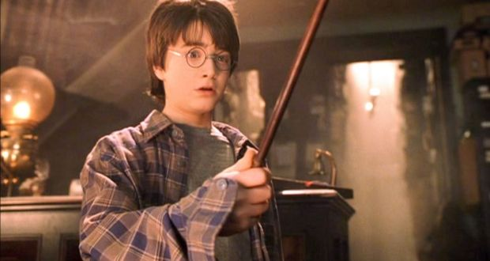
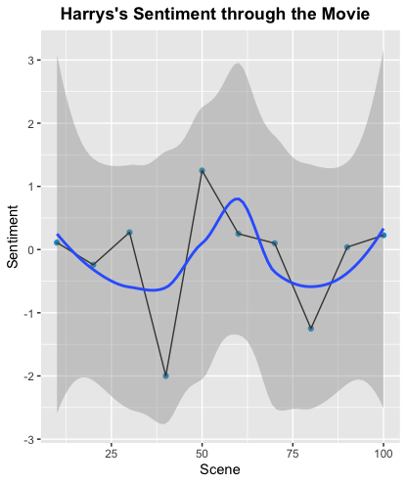
Sentiment Analysis
Turbulent Character with a large range
Highest around scene 35 (Troll Scene)
Lowest in two points

Slide 18
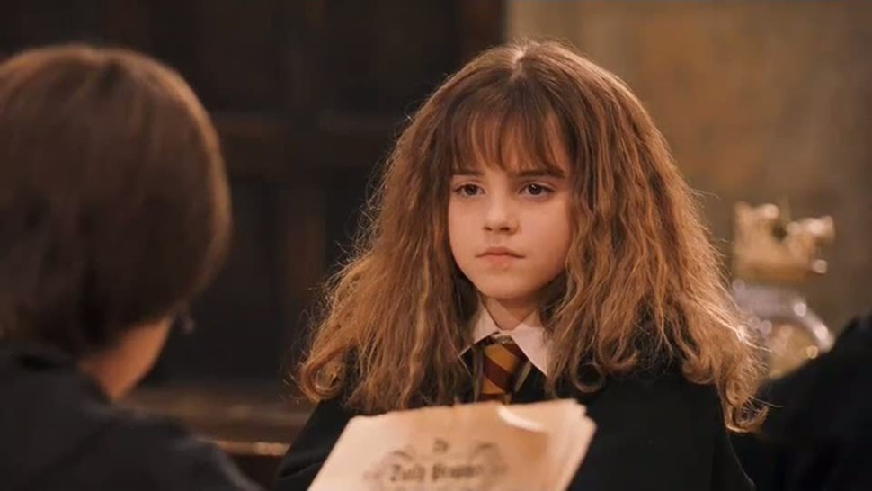
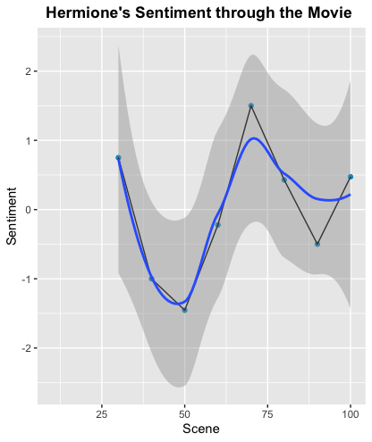
Sentiment Analysis
Lowest is around scene 35 (Capture By Troll)
Highest is around scene 56 (her realization of the sorcerer's stone)

Slide 19
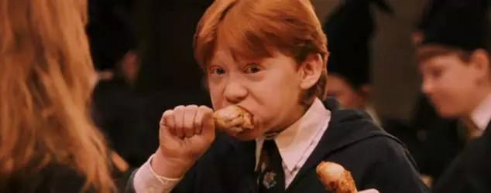
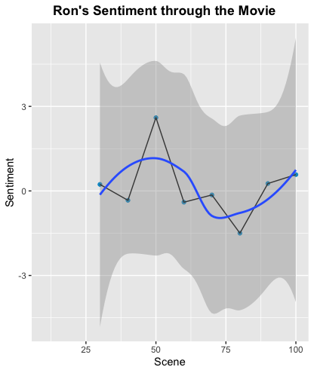
Sentiment Analysis
Highest when saving Hermione
Relatively consistent with story progression when compared with other characters

Slide 20
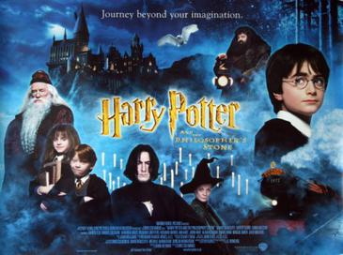
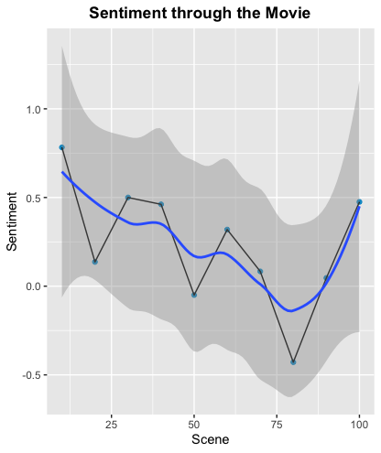
Sentiment Analysis
Story progression towards a climax and overcomes it

Slide 21
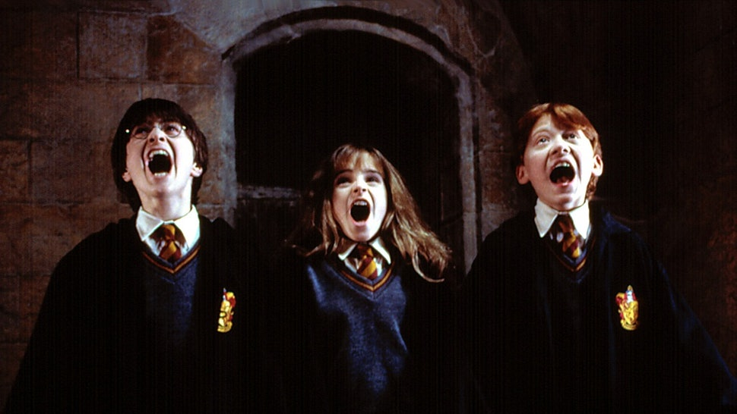
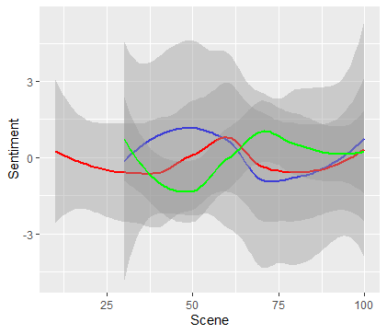
Sentiment Analysis
Harry
Ron
Hermione
Relationships at lows and highs
They help each other when they need help most
Their personalities complement with each other which make them a great team

Slide 22
E
Social Network Analysis

Slide 23
Social Network Analysis
What is Social Network Analysis?
A set of relational method to understand and identify the connections among the nodes, characters and entities .
50%
Network Components
50%
Nodes - Characters , Entity , Organization etc.
Edges - Relation

Slide 24
Social Network Analysis
Measuring Networks
01
Answers which nodes are at the center of the network.
Centrality
Degree
Closeness
Betweenness
Standard Centrality Measures
02

Slide 25


Social Network Analysis
Degree
Application -Node which is likely to hold more information or individual which can quickly connect with wider network.
Number of links held by each node

Slide 26
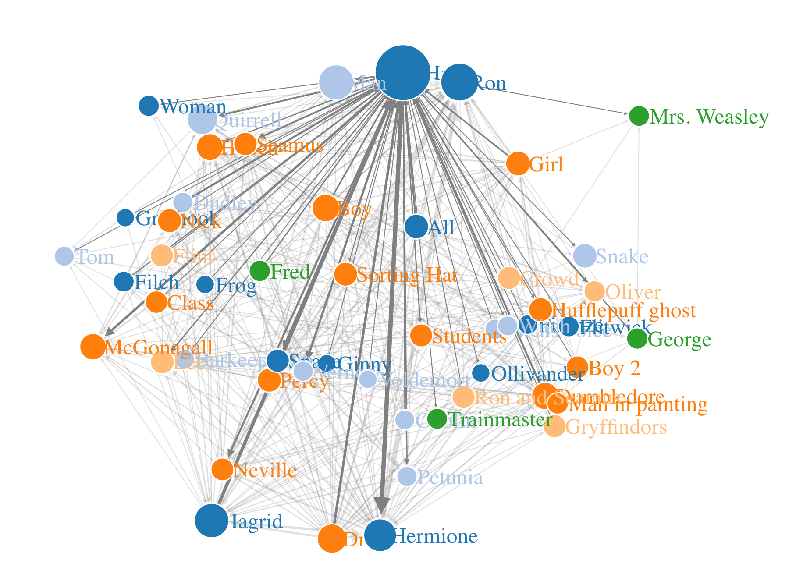
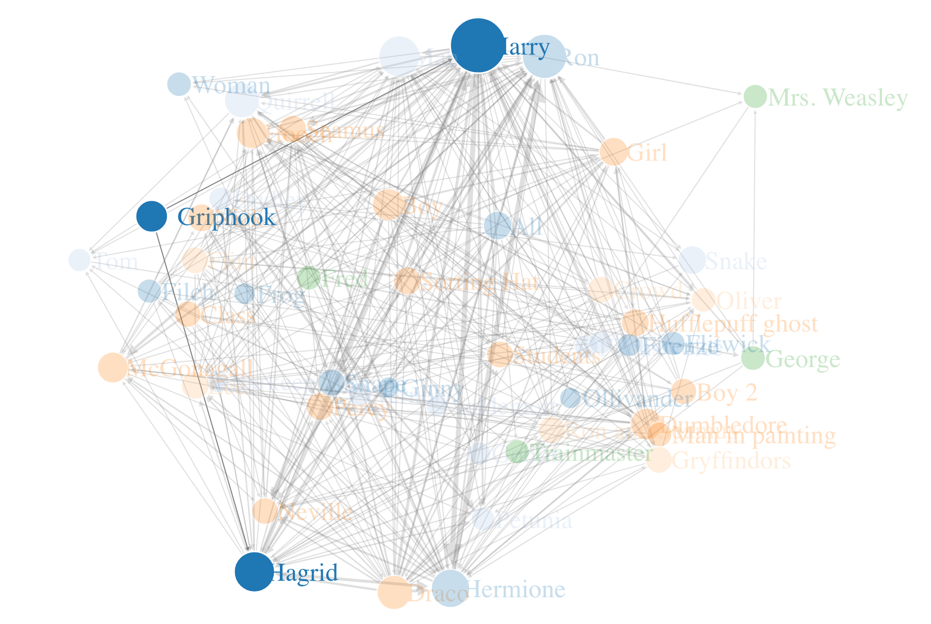
Social Network Analysis
Characters | Degree
Harry | 51
Ron | 36
Hermione | 34
Hagrid | 31
. | .
. | .
. | .
Griphook | 2

Slide 27

Social Network Analysis
Closeness
Scores each node based on their ‘closeness’ to all other nodes within the network.
Application: For finding the individuals who are best placed to influence the entire network most quickly.

Slide 28
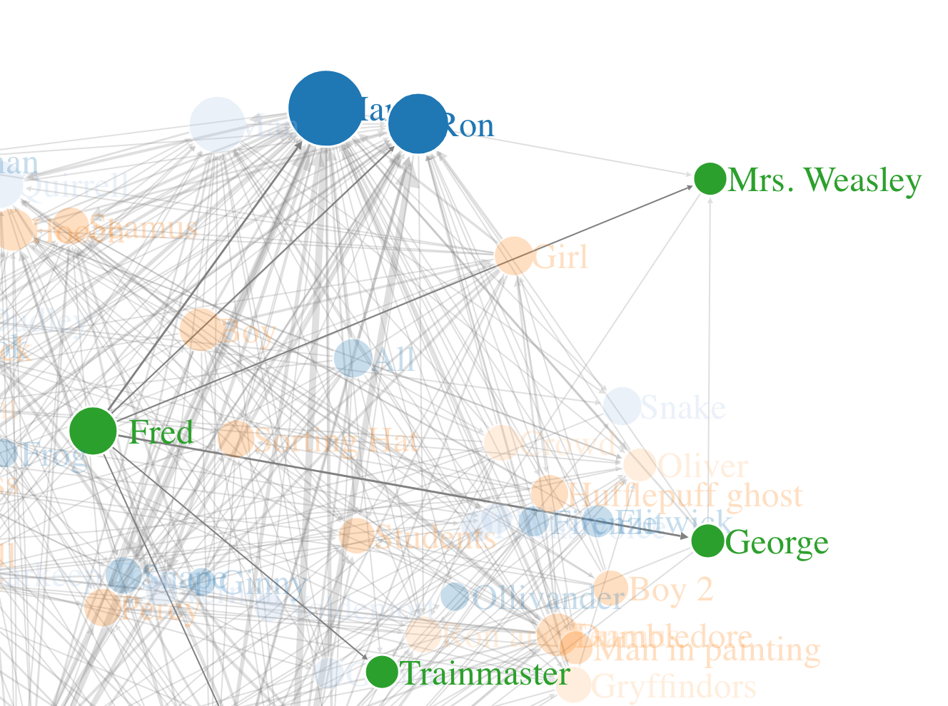
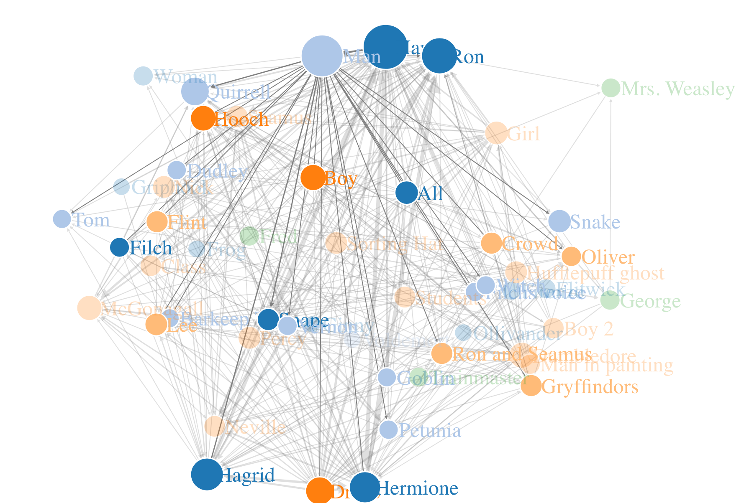
Social Network Analysis
Characters | Closeness
Harry | 0.0126
Man | 0.0116
Ron | 0.0114
Hermione | 0.0113
. | .
. | .
. | .
Fred | 0.0008

Slide 29

Social Network Analysis
Betweenness
Measures the number of times a node lies on the shortest path between other nodes.
Application: For finding the individuals who influence the flow around a system.

Slide 30
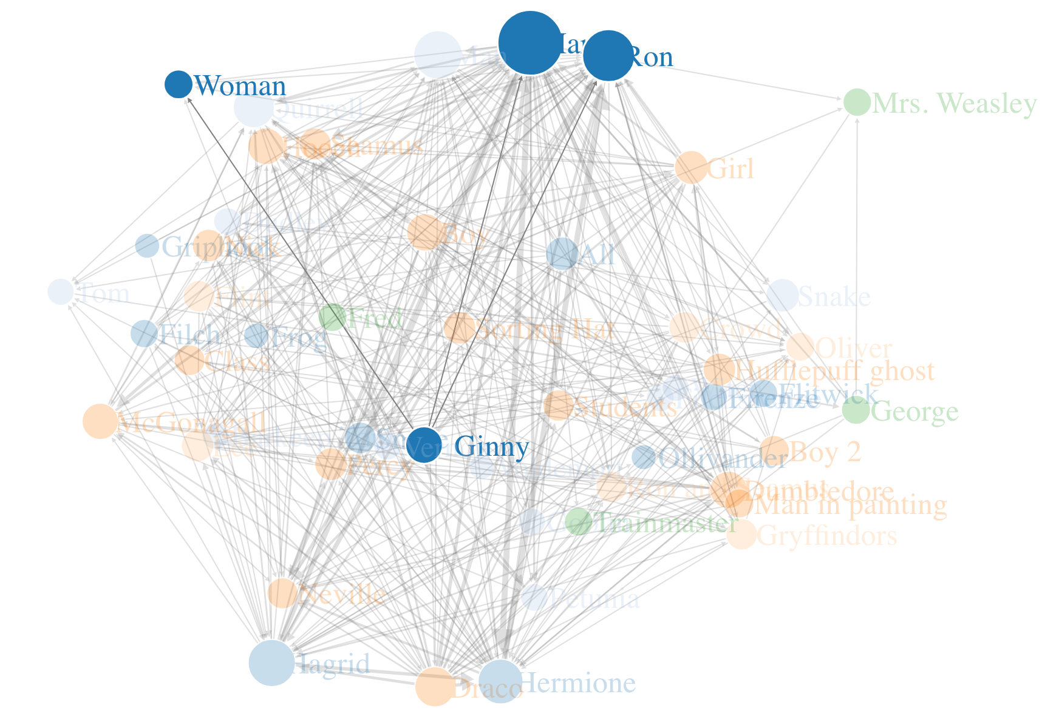
Social Network Analysis
Characters | Betweeness
Harry | 289
Ron | 138
Man | 104
Hagrid | 96
. | .
. | .
. | .
Ginny | 0.1

Slide 31

Social Network Analysis
Social Network
Harry Potter and the Sorcerer’s Stone

Slide 32
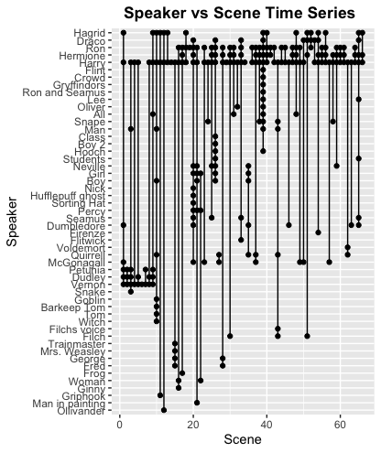
Character Time Series
Social Network Analysis

Slide 33
03
RESULTS/INSIGHTS

Slide 34
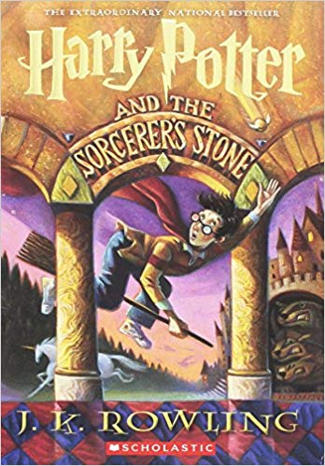
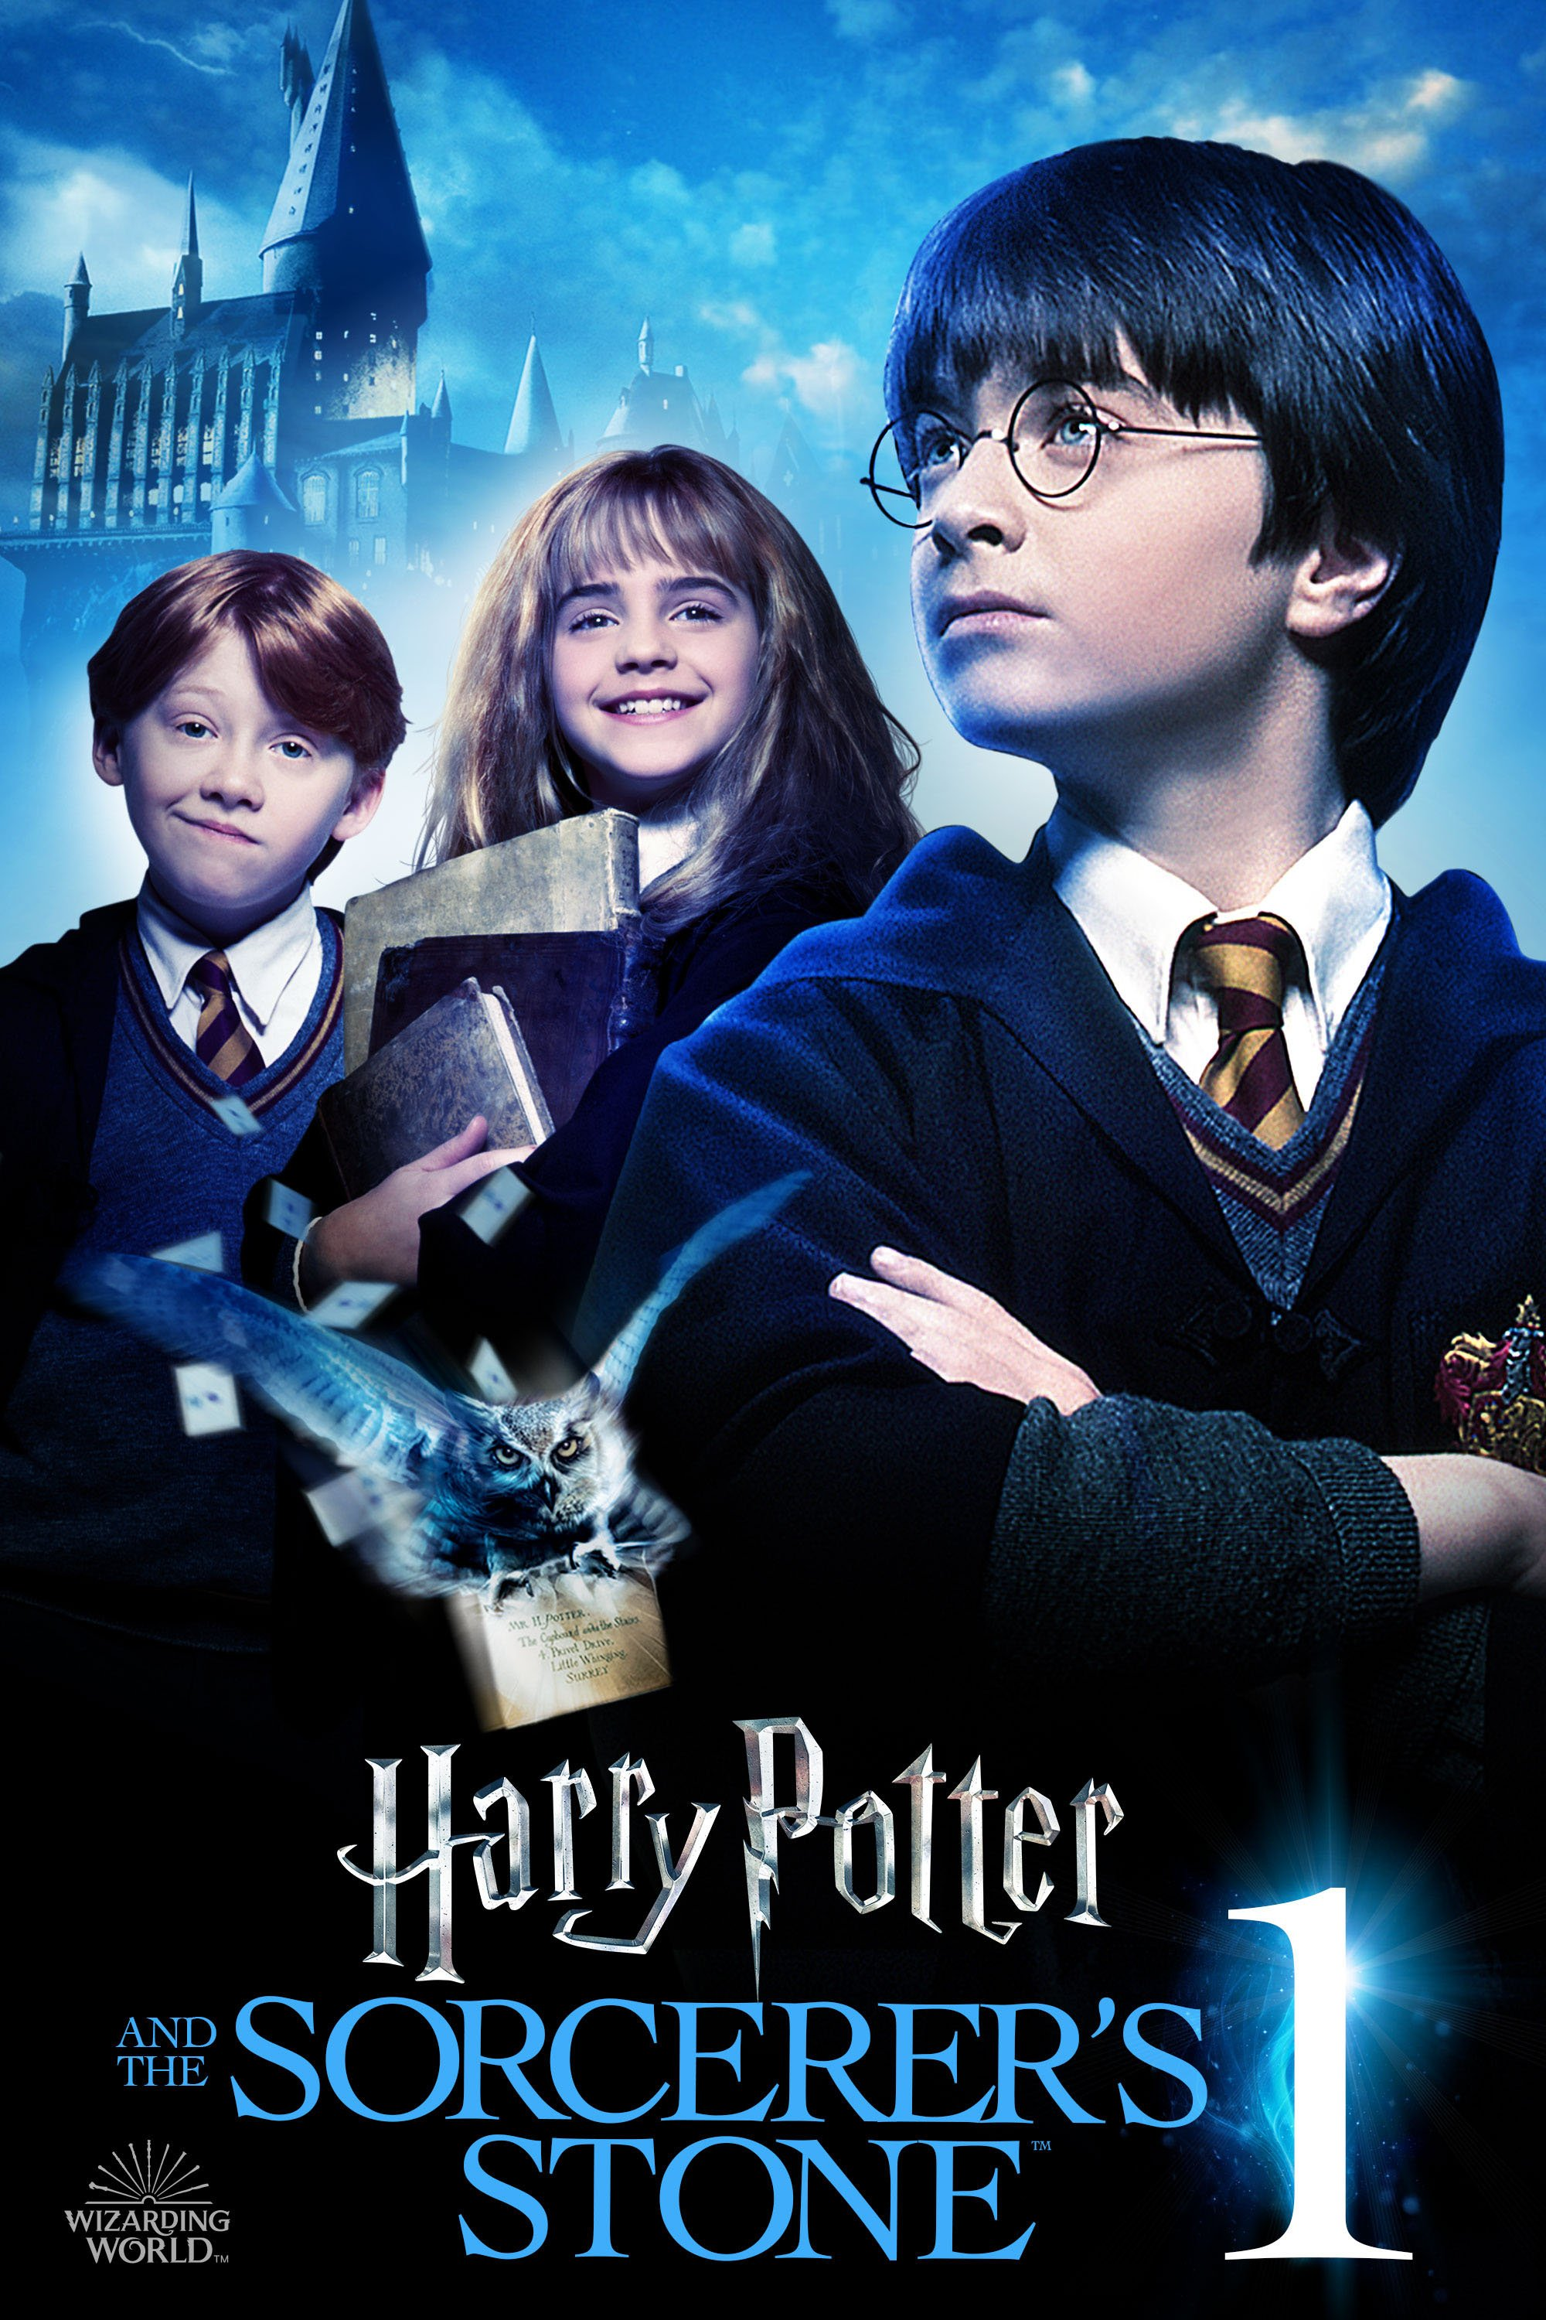
RESULTS/
INSIGHTS
Take people into Harry’s World
Further developed the marketing strategy
Images from movie were released sparingly before it hit theaters
Actors’ images became synonymous with the Potter Brand

Slide 35
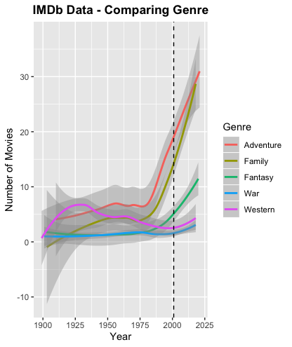
RESULTS/
INSIGHTS
Genre
The three genres Harry Potter falls
Exponential Growth
Slopes are almost unmatched

Slide 36
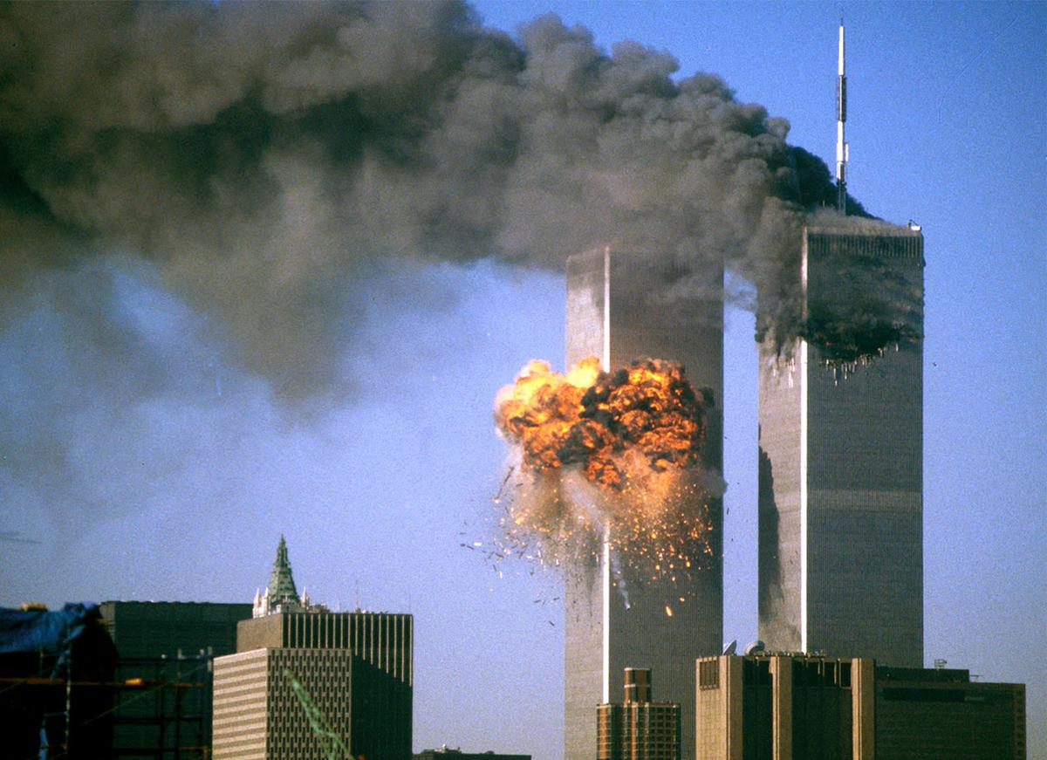
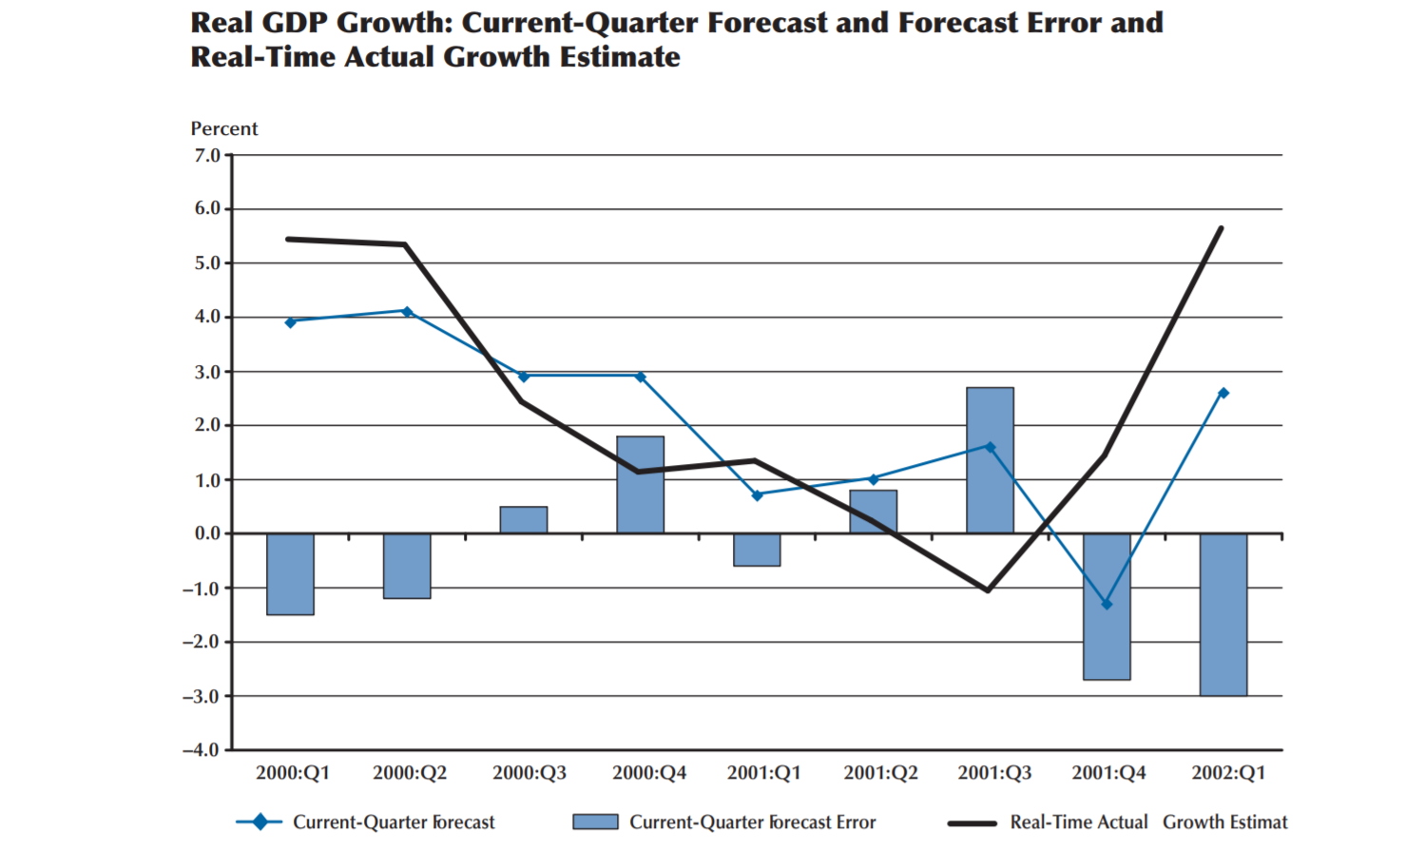
RESULTS/
INSIGHTS
2001: A Year of Hardships

Slide 37

RESULTS/
INSIGHTS
What Is 2001 Lacking?
WIZARD
PARENTS
DRAGON
MAGIC
FAMILY

Slide 38
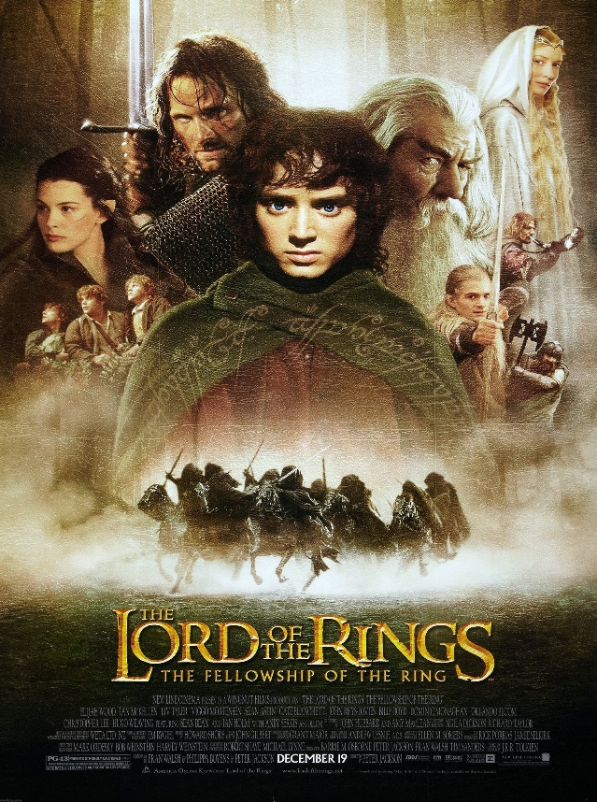
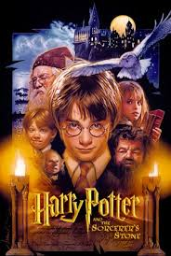
RESULTS/
INSIGHTS
Harry Potter vs Lord Of The Rings
IMDb Rating: 8.8
US Revenue: $313M
IMDb Rating: 7.6
US Revenue: $318M

Slide 39
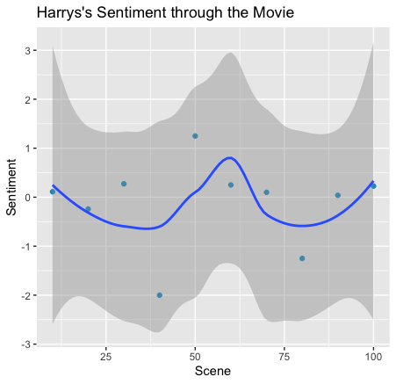
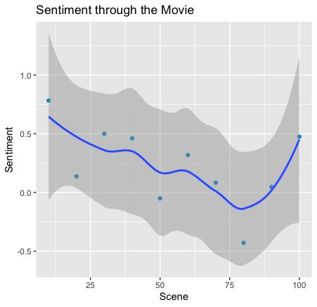
RESULTS/
INSIGHTS
The Sentiment Sweet Spot

Slide 40
CONCLUSION
What makes HARRY POTTER AND THE SORCERER’S STONE so uniquely successful?
It is the right movie appears in the right time, right place

Slide 41
04
LIMITATIONS

Slide 42
LIMITATIONS
01
Negative and Positive Connotation for Words
02
Outside Data Available
03
Accuracy with Preprocessing Algorithm

Slide 43
QUESTIONS
THANK YOU

